Slide 1


PSYCHOLOGY 2e
Chapter 11 PERSONALITY
PowerPoint Image Slideshow

Slide 2

PERSONALITY
(credit: modification of work by Nicolas Alejandro)
What makes two individuals have different personalities?

Slide 3
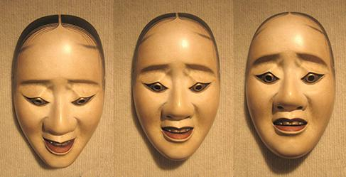
WHAT IS PERSONALITY?
Personality – the long-standing traits and patterns that propel individuals to consistently think, feel, and behave in specific ways.
Comes from the Latin word persona (a mask worn by an actor).
In ancient times, theatrical masks were used to represent/project a specific personality trait.
Happy, sad, impatient, shy, fearful, curious, helpful. What characteristics describe your personality?

Slide 4
HISTORICAL PERSPECTIVES
Hippocrates (370 BCE)
Theorized that personality traits and human behaviors are based on four separate temperaments associated with four fluids (“humors”) of the body.
Choleric – yellow bile from the liver.
Melancholic – black bile from the kidneys.
Sanguine – red blood from the heart.
Phlegmatic – white phlegm from the lungs.
Galen
Believed both diseases and personality differences could be explained by imbalances in the humors and that each person exhibits one of the four temperaments.
Prevalent view for over 1000 years and through the Middle Ages.
Choleric – passionate, ambitious, and bold.
Melancholic – reserved, anxious, and unhappy.
Sanguine – joyful, eager, and optimistic.
Phlegmatic – calm, reliable, and thoughtful.

Slide 5
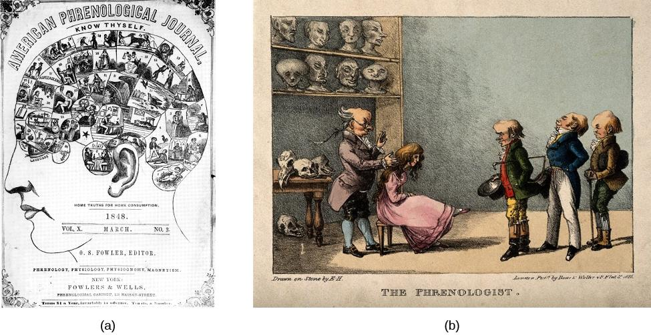
HISTORICAL PERSPECTIVES PHRENOLOGY
Franz Gall (1780)
Proposed that the distances between bumps on the skull reveal a person’s personality traits, character, and mental abilities.
Discredited for lack of empirical support.
Gall developed a chart that depicted which areas of the skull corresponded to particular personality traits or characteristics (Hothersall, 1995).
An 1825 lithograph depicts Gall examining the skull of a young woman.
(credit b: modification of work by Wellcome Library, London)

Slide 6
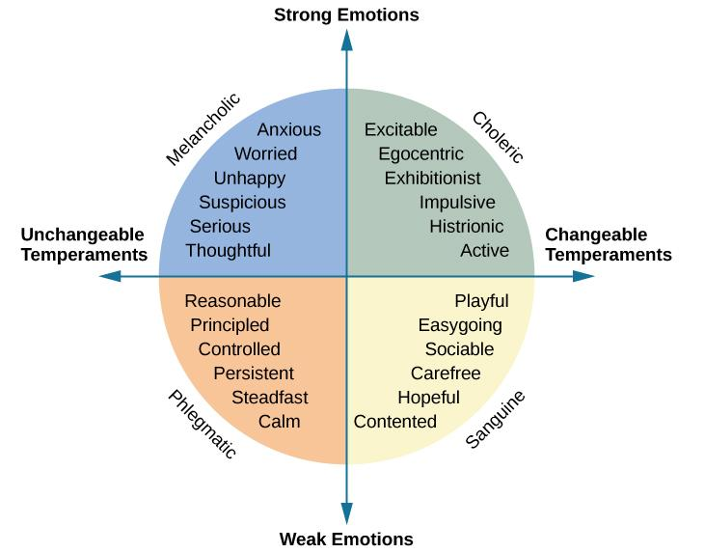
HISTORICAL PERSPECTIVES
Immanuel Kant (18th century)
Agreed with Galen that individuals could be categorized into one of the four temperaments.
Developed a list of traits to describe the personality of each of the four temperaments.
Wilhelm Wundt (19th century)
Suggested that personality could be described using two major axes:
Emotional/non-emotional – separated strong emotions (melancholic, choleric) from the weak emotions (phlegmatic, sanguine).
Changeable/unchangeable – divided the changeable temperaments (choleric, sanguine) from the unchangeable ones (melancholic, phlegmatic).

Slide 7
HISTORICAL PERSPECTIVES
Psychodynamic Perspectives (20th Century)
Sigmund Freud:
First comprehensive theory of personality explaining both normal and abnormal behaviors.
Proposed that unconscious drives influenced by sex, aggression and childhood sexuality influence personality.
Neo-Freudians:
Agreed that childhood experiences matter.
Less emphasis on sex.
Focused on the social environment and effects of culture on personality.

Slide 8
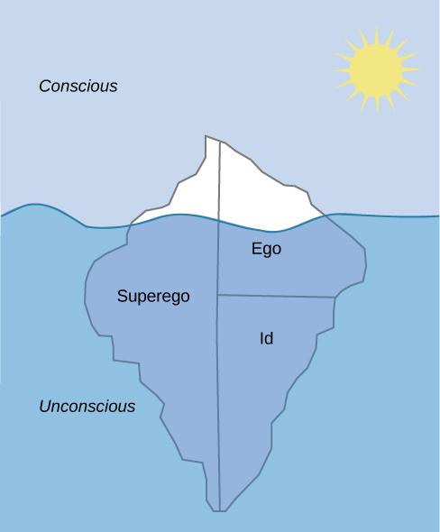
LEVELS OF CONSCIOUSNESS
Unconscious – mental activity that we are unaware of and are unable to access.
According to Freud:
We are only aware of a small amount (about one-tenth) of our mind’s activities and most of it remains hidden from us in our unconscious.
Unacceptable urges and desires are kept in our unconscious through repression.
The information in our unconscious affects our behavior, although we are unaware of it.
Freudian slip - Freud suggested that slips of the tongue (saying a word you did not intend to say) are sexual/aggressive urges accidently slipping out of our unconscious.

Slide 9
ID, EGO & SUPEREGO
Freud posited that personality results from efforts to balance two competing forces.
Biological aggressive and pleasure-seeking drives.
Internal (socialized) control over these pleasure-seeking drives.
Freud described this process as an interaction between three systems.
Id
Contains primitive urges (for hunger, thirst, and sex).
Impulsive, instinctual.
Operates on the ”pleasure principle” – seeks immediate gratification.
Superego
Develops through interactions with others, learning social rules for right and wrong.
Moral compass that tells us how we should behave based on rules..
Strives for perfection.
Judges behavior - leads to feelings of pride or guilt.
Ego (self)
Attempts to balance the id with the superego.
Rational
Operates on the “reality principle” – helps the id satisfy desires in a realistic way.
The part of the personality seen by others.

Slide 10
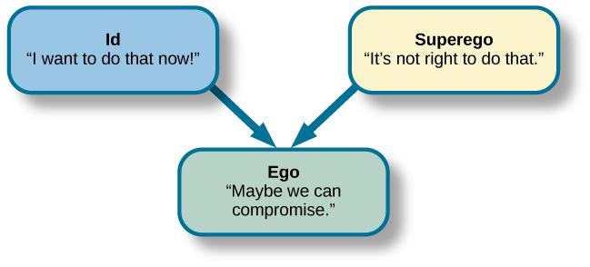
ID, EGO, & SUPEREGO
Effects on Personality
Balanced id and superego → healthy personality.
Imbalanced id and superego → neurosis (tendency to experience negative emotions), anxiety disorders, or unhealthy behaviors.

Slide 11
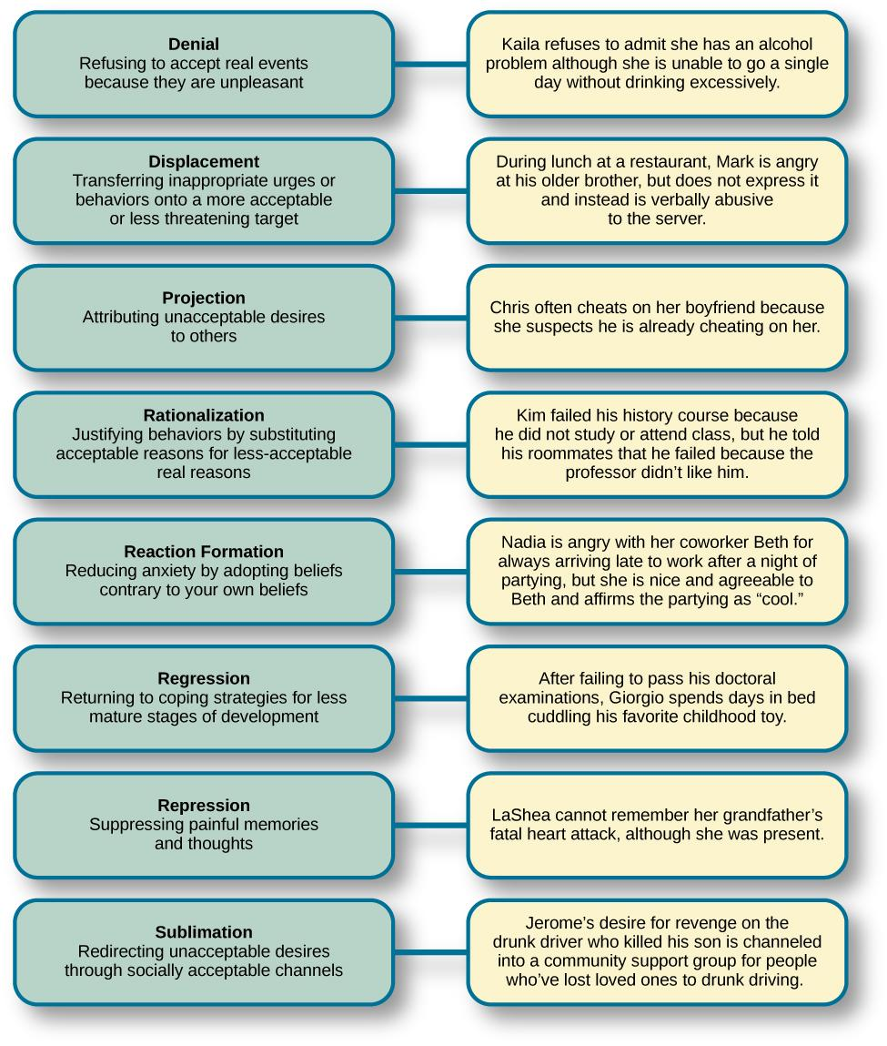
DEFENSE MECHANISMS
Unconscious protective behaviors that work to reduce anxiety.
Used by the ego to restore balance between the id and superego.
Freud believed them to be used by everyone but that overuse could be problematic.

Slide 12
STAGES OF PSYCHOSEXUAL DEVELOPMENT
Freud theorized that children pass through five psychosexual stages.
In each stage, pleasure-seeking urges (id) are focused on a different erogenous zone (part of the body).
Lack of proper nurturing and parenting during conflicts results in the person becoming stuck/fixated in that stage.
Oral Stage (Birth – 1 year)
Erogenous zone – mouth.
Pleasure – from eating and sucking.
Major conflict – being weaned from bottle or breast.
Adult fixation – smoking, overeating, nail biting.
Anal Stage (1-3 years)
Erogenous zone – anus.
Pleasure – from bowel and bladder movements.
Major conflict – toilet training.
Adult fixation – anal-retentive personality (stingy, stubborn, need for order and neatness), anal-expulsive personality (messy, careless, disorganized, prone to emotional outbursts).

Slide 13
STAGES OF PSYCHOSEXUAL DEVELOPMENT
Phallic Stage (3-6 years)
Erogenous zone – genitals.
Major conflict – child feels a desire for the opposite-sex parent, and jealousy and hatred toward the same-sex parent.
Oedipus complex (boys) – desire for mother’s attention, urge to replace father. Afraid of being punished by father for these feelings (castration anxiety).
Electra complex (girls) - desire for father’s attention, urge to replace mother. Angry at mother for not providing them with a penis (penis envy).
Adult fixation – vanity, over-ambition.
Latency Stage (6-12 years)
Erogenous zone – none.
Sexual feelings are dormant as children focus on school, friendships, hobbies and engage with peers of the same-sex.
Genital Stage (12+)
Erogenous zone – genitals.
Sexual reawakening – urges are redirected from parents to more socially acceptable partners.

Slide 14
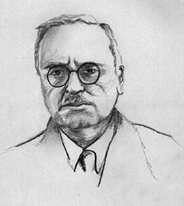
ALFRED ADLER
Individual psychology
Focuses on our drive to compensate for feelings of inferiority.
Inferiority complex – A person’s feelings that they lack worth and don’t measure up to the standards of others or of society.
Social motives thought to be the force behind thoughts, emotions, and behaviors.
Placed focus on social connections during childhood development.
Believed happiness can be found in working together for the betterment of all.
Viewed main goal of psychology to be “to recognize the equal rights and equality of others”.
Saw conscious processes as more important.
Theorized that birth order shapes our personality.
Adler identified three fundamental social tasks all individuals must experience.
Occupational tasks – careers.
Societal tasks – friendship.
Love tasks – finding an intimate partner.

Slide 15
ERIK ERIKSON
Psychosocial theory of Development
Personality develops throughout the lifespan.
Emphasizes importance of social relationships at each stage.
Development of a healthy personality and sense of competence depend on successfully completing each of the 8 stages.

Slide 16
CARL JUNG
Analytical Psychology
Focused on working to balance conscious and unconscious thought.
Carl Jung acknowledged the concept of a personal unconscious but was also interested in exploring the collective unconscious.
Collective unconscious – universal version of personal unconscious, holding mental patterns, or memory traces, which are common to all of us.
Archetypes –patterns that exist in our collective unconscious across cultures/societies.
Represented by universal themes in various cultures reflecting common experiences of people around the world.
Integration of unconscious archetypal aspects of the self seen as part of self-realization process.
Persona – A mask that we consciously adopt.
Derived from conscious experiences and our collective unconscious.
A compromise between our true self and the self that society expects us to be (hiding parts of the self that do not align with societies expectations).

Slide 17
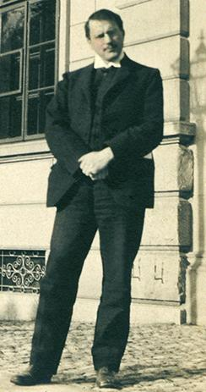
CARL JUNG
Extroversion vs Introversion
Jung’s most important contributions to the field of personality psychology was the idea of extroversion and introversion to explain different attitudes towards life.
Introverts
Extroverts
Energized by being alone | Energized by being with others
Avoids attention | Seeks attention
Speaks slowly & softly | Speaks quickly & loudly
Thinks before speaking | Thinks out loud
Stays on one topic | Jumps from topic to topic
Prefers written communication | Prefers verbal communication
Pays attention easily | Distractible
Cautious | Acts first, thinks later

Slide 18
KAREN HORNEY
Agreed with Jung that individuals have the potential for self-realization and believed the goal of psychoanalysis should be moving toward a healthy self.
Disagreed with the idea of penis envy – suggested that any jealousy is culturally based.
Differences in personality between men and women is culturally based.
Men have womb envy because they cannot give birth.
Many of Horney’s theories focused on unconscious anxiety.
Normal growth can be blocked by basic anxiety stemming from needs not being met.
3 styles of coping used by children to relieve anxiety:
Moving toward people – affiliation and dependence.
As adults – likely to have an intense need for love and acceptance.
Moving against people – aggression and assertiveness.
As adults – likely to lash out and exploit others.
Moving away from people – detachment and isolation.
As adults – likely to avoid love/friendship and avoid interaction with others.

Slide 19
THE BEHAVIORAL PERSPECTIVE
Learning approaches to personality focus on observable, measurable phenomena.
Skinner
We learn to behave in particular ways.
Personality is shaped by reinforcements and consequences in the environment.
Personality develops over our entire life.
Personality can vary as we experience new situations.

Slide 20
THE SOCIAL-COGNITIVE PERSPECTIVE
Bandura
Agreed that personality develops through learning but disagreed with the behaviorist approach because thinking and reasoning are important parts of learning.
Social-cognitive theory – emphasizes both learning and cognition as sources of individual difference in personality.
Factors in personality development:
Reciprocal Determinism – cognitive processes (beliefs, expectations, and personality characteristics), behavior, and context (environment/situation) all interact.
Observational learning – learning by observing someone else’s behavior and it’s consequences.
Teaches us which behaviors are acceptable and rewarded in our culture.
Teaches us which behaviors are socially unacceptable.
Self-efficacy – level of confidence in our own abilities, developed through social experiences.
Affects how we approach challenges.

Slide 21
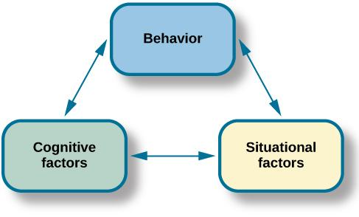
RECIPROCAL DETERMINISM
Bandura proposed the idea of reciprocal determinism: Our behavior, cognitive processes, and situational context all influence each other.

Slide 22
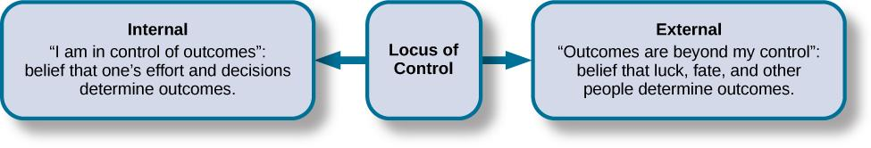
JULIAN ROTTER LOCUS OF CONTROL
Locus of control – beliefs about the power we have over our lives.
Proposed as a cognitive factor that affects learning and personality development.
Internal locus of control – tend to believe that most of our outcomes are the direct result of our efforts.
Perform better academically, achieve more in careers, more independent, healthier, less depressed.
External locus of control – tend to believe that our outcomes are outside of our control.
Believe lives are controlled by other people, luck, or chance.
Locus of control occurs on a continuum from internal to external.

Slide 23
WALTER MISCHEL THE PERSON-SITUATION DEBATE
Mischel’s Findings:
Behavior was inconsistent across different situations but more consistent within situations.
Behavior is consistent in equivalent situations across time.
This data did not support the theory that a person’s personality traits are consistent across situations - triggered the person-situation debate among psychologists.
Marshmallow Study:
Study on self-regulation (aka will power) – ability to delay gratification.
Children were placed in a room with one marshmallow on the table - was told that they could either eat it now, or wait until the researcher returned and could then have two marshmallows.
Revealed that children differ in levels of self-control.
Children that had more self-control (waited for two marshmallows) in preschool were more successful in high school.
Children that had poorer self-control (took the one marshmallow) in preschool were more likely to have academic and behavioral problems.
Mischel’s approach to personality – People use cognitive processes to assess the situation in their own way and behave in accordance with that interpretation.

Slide 24
HUMANISTIC APPROACHES
The humanistic approach focuses on how healthy people develop.
Abraham Maslow
Studied people he considered healthy, creative, and productive (Albert Einstein, Eleanor Roosevelt, Thomas Jefferson, Abraham Lincoln).
Found that they shared similar characteristics – open, creative, loving, spontaneous, compassionate, concerned for others, accepting of themselves.
Carl Rogers
Linked personality to self-concept (thoughts and feelings about ourselves).
Divided the self into the idea self and the real self.
Ideal self – the person you would like to be.
Real self – the person you actually are.
Believed we needed to find congruence between the ideal and real self – thoughts about ideal self and real self are similar.
High congruence → greater sense of self-worth and a health, productive life.
Incongruence → maladjustment.

Slide 25
BIOLOGICAL APPROACHES
Perspective that differences in our personalities can be explained by inherited predispositions and physiological processes
.
Heritable Traits
Minnesota Study of Twins Reared Apart:
Found that identical twins, whether raised together or apart, have very similar personalities.
Suggests the heritability of some personality traits.
Traits with more than a 0.50 heritability ratio – leadership, obedience to authority, a sense of well-being, alienation, resistance to stress, and fearfulness.

Slide 26
BIOLOGICAL APPROACHES
Temperament
Temperament appears very early in life (suggesting a biological basis).
Babies can be categorized into one of three temperaments – easy, difficult, or slow to warm up.
Environmental factors and maturation can affect expression of personality.
Two dimensions of temperament important to adult personality:
Reactivity – how we respond to new or challenging environmental stimuli.
Self-regulation – ability to control responses.

Slide 27
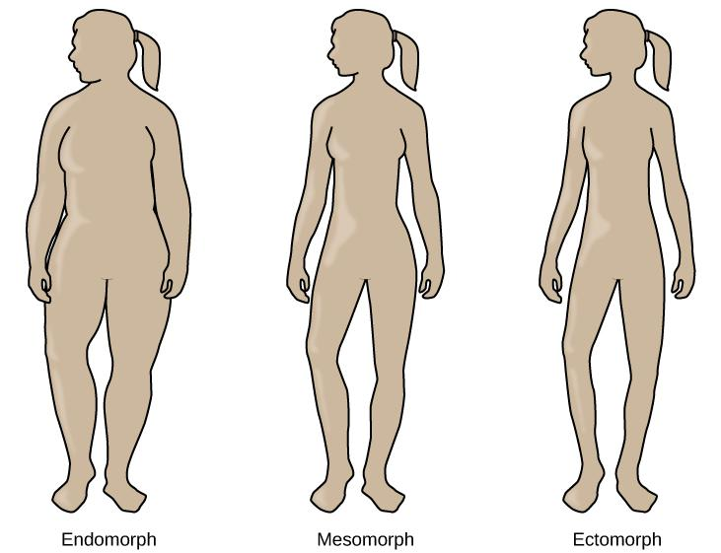
SOMATOTYPES
William H. Sheldon believed body type could be linked to personality.
He proposed three somatotypes:
Endomorphs – relaxed, comfortable, good-humored, even-tempered, sociable, and tolerant.
Mesomorphs – adventurous, assertive, competitive, and fearless.
Ectomorphs – Anxious, self-conscious, artistic, thoughtful, quiet, and private.

Slide 28
TRAIT THEORISTS
Believe that people have certain traits (characteristics or ways of behaving).
For example, optimistic or pessimistic, sociable or shy.
Gordon Allport
Found 4,500 words in the English language to describe people and organized them into three categories.
Cardinal traits – dominates entire personality (rare).
Central traits – make up our personality.
Secondary traits – less obvious or consistent, present under certain circumstances (e.g., preferences, attitudes).
Raymond Cattell
Narrowed Allport’s list to about 171 traits.
Identified 16 dimensions of personality – instead of a present being present or absent, people are scored on a continuum.

Slide 29
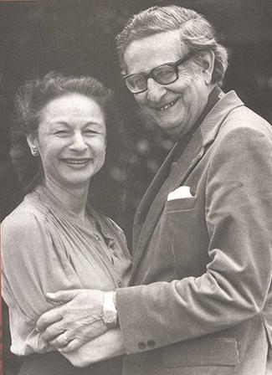
HANS & SYBIL EYSENCK
Hans and Sybil Eysenck focused on temperament and believed that our personality traits are influenced by our genetic inheritance.
2 specific personality dimensions:
Extroversion/Introversion.
High in extroversion – sociable, outgoing.
High in introversion – high need to be alone, engage in solitary behaviors.
Neuroticism/Stability.
High in neuroticism – anxious, overactive sympathetic nervous system.
High in stability – more emotionally stable.
(credit: "Sirswindon"/Wikimedia Commons)

Slide 30
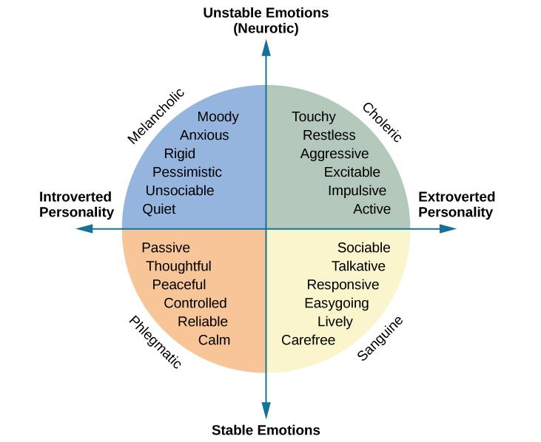
HANS & SYBIL EYSENCK
The Eysencks described two factors to account for variations in our personalities: extroversion/introversion and emotional stability/instability.

Slide 31
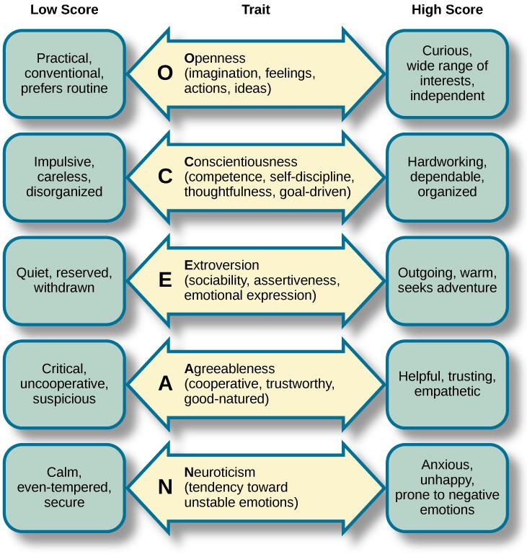
FIVE FACTOR MODEL
In the Five Factor Model, each person has five traits, known as the Big Five personality traits.
Each trait is scored on a continuum from high to low.
The first letter of each trait spells the mnemonic OCEAN.
Openness to experience
Conscientiousness
Extroversion.
Agreeableness.
Neuroticism.

Slide 32
HEXACO MODEL
The HEXACO Traits
Trait | Example Aspects of Trait
(H) Honesty-humility | Sincerity, modesty, faithfulness
(E) Emotionality | Sentimentality, anxiety, sensitivity
(X) Extraversion | Sociability, talkativeness, boldness
(A) Agreeableness | Patience, tolerance, gentleness
(C) Conscientiousness | Organization, thoroughness, precision
(O) Openness | Creativity, inquisitiveness, innovativeness

Slide 33
CULTURAL UNDERSTANDINGS OF PERSONALITY
Culture is one of the most important environmental factors that influences personality.
Culture – beliefs, customs, art, and traditions of a particular society.
Are personality traits the same across cultures or are there variations?
There are both universal and culture-specific aspects that account for variation in personalities.
Examples:
Asian cultures – more collectivist, tend to be less extroverted.
Central and South American cultures – tend to score higher on openness to experience.
Europeans – tend to score higher on neuroticism.

Slide 34
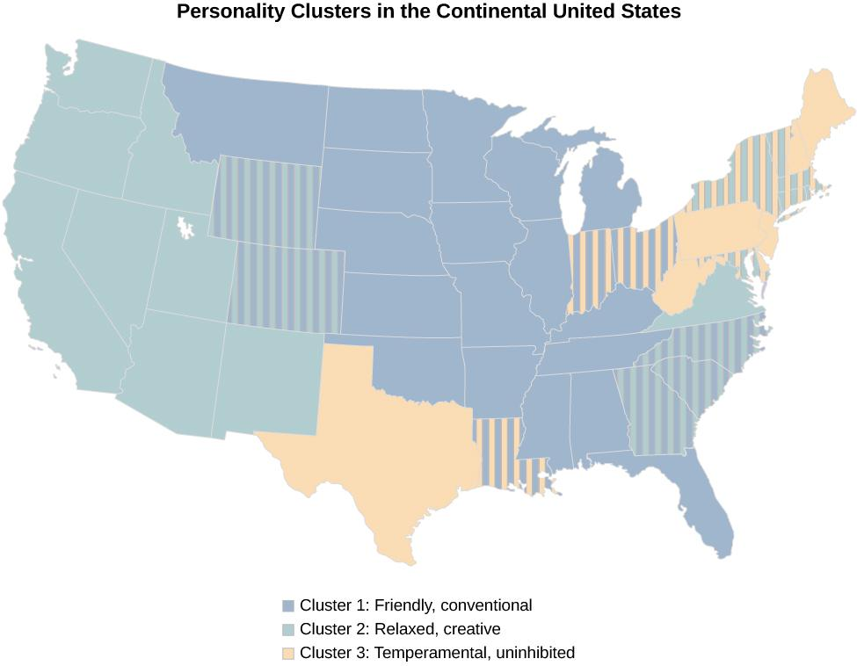
REGIONAL DIFFERENCES
(Rentfrow et al., 2013).
Researchers found three distinct regional personality clusters in the United States. People tend to be friendly and conventional in the Upper Midwest and Deep South; relaxed, emotionally stable, and creative in the West; and stressed, irritable, and depressed in the Northeast.
One explanation for this is selective migration - people choose to move to places that are compatible with their personalities and needs.

Slide 35
INDIVIDUALIST VS COLLECTIVIST CULTURES
Individualist cultures
Value independence, competition, and personal achievement.
Mainly Western nations such as the U.S. England, and Australia.
People display more personally oriented personality traits.
Collectivist Cultures
Value social harmony, respectfulness, and group needs over individual needs.
Asia, Africa, and South America.
People display more socially oriented personality traits.

Slide 36
SELF-REPORT INVENTORIES
Personality testing is often used:
To screen applicants for employment and job training.
In criminal cases and custody battles.
To assess psychological disorders.
Self-Report Inventories
Objective test to assess personality.
Often use multiple-choice items or numbered scales (Likert scales).
Minnesota Multiphasic Personality Inventory (MMPI):
One of the most widely used personality inventories.
Originally developed to assist in diagnosing psychological disorders.
Newest version (MMPI-2-RF) has 338 questions.
Scored on 10 scales – hypochondriasis, depression, hysteria, psychopathic deviance, masculinity vs femininity, paranoia, psychasthenia (obsessive/compulsive qualities), schizophrenia, hypomania, and social introversion.

Slide 37
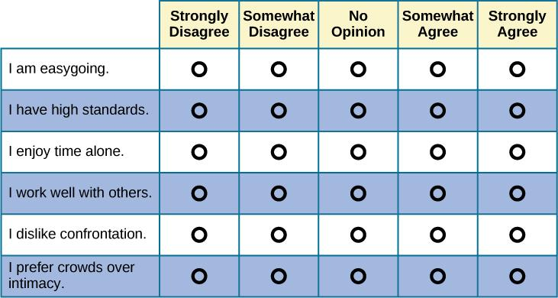
LIKERT SCALES
If you’ve ever taken a survey, you are probably familiar with Likert-type scale questions. Most personality inventories employ these types of response scales.

Slide 38
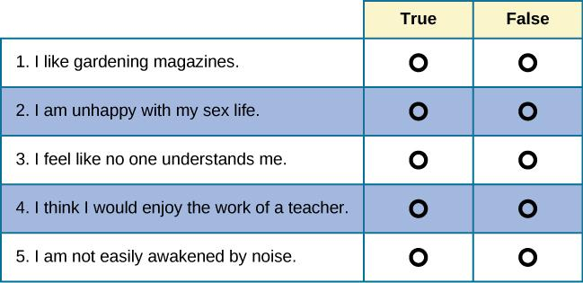
MMPI
These true/false questions resemble the kinds of questions you would find on the MMPI.

Slide 39
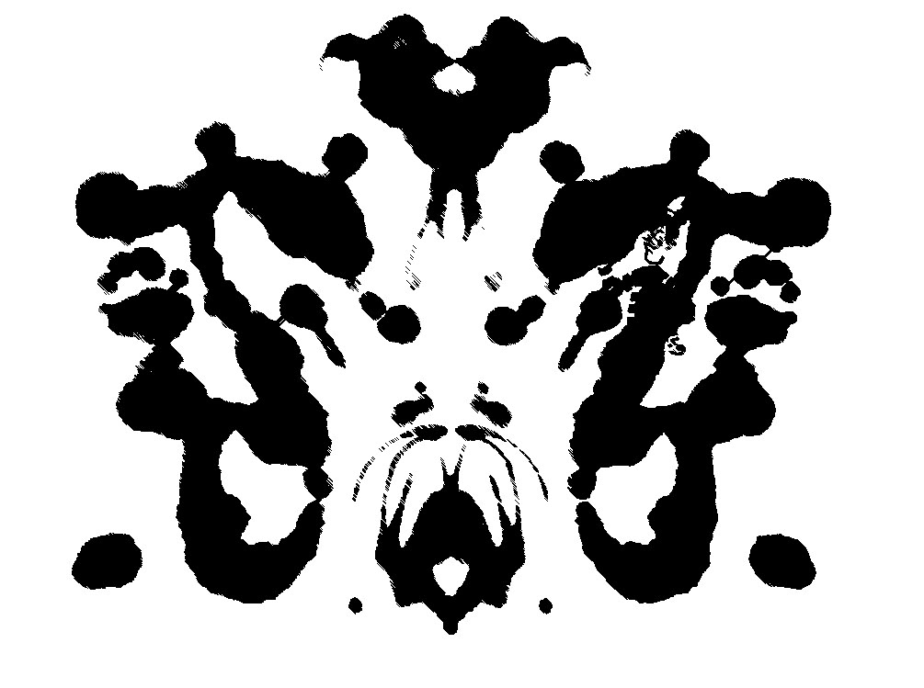
PROJECTIVE TESTS
Projective testing relies on projection (defense mechanism) to assess unconscious processes.
Ambiguous cards are shown to individual who is asked to tell a story, interpret an image, or complete a sentence.
Individual will project feelings, impulses, and desires onto the cards.
Rorschach Inkblot Test – individual interprets a series of symmetrical inkblot cards, revealing unconscious feelings and struggles.
Thematic Apperception Test (TAT) – individual tells a story about 8-12 ambiguous cards, giving insight into their social world, revealing hopes, fears, interests, and goals.
Rotter Incomplete Sentence Blank (RISB) – Individual is asked to complete 40 incomplete sentences as quickly as possible to reveal desires, fears, and struggles.

Slide 40
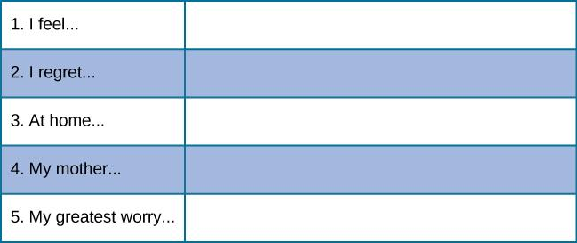
ROTTER INCOMPLETE SENTENCE BLANK
These incomplete sentences resemble the types of questions on the RISB.
How would you complete these sentences?

